Slide 1
Database Fundamentals
Lecturer: Yahia Momtaz
Notes:
http://www.youtube.com/watch?v=IzbCLooj-M8

Slide 2
Objective
This course is designed to introduce the fundamentals of
Databases. The students will develop skills in the design,
construction, modification, and use of databases. Structured Query
Language (SQL) will be emphasized.
References
Ramez Elmasri, Fundamentals of Database Systems
C. J. Date: An Introduction to Database Systems,

Slide 3
Chapter 1 : Introduction
After Completing this chapter, you should be able to do the following:
Define Database, Database System
Identify the Database Properties
Define DBMS
Functions of DBMS
Advantages and Disadvantages of Database
Systems

Slide 4
Chapter 1 : Introduction
تعريف قواعد البيانات:
قواعد البيانات هى مكان تخزين بيانات خاصة ببرنامج ( وهى مجموعة من الجداول المترابطة مع بعض )
برنامج = سوفتوير = سيستم = نظام الشركة = Application
اى برنامج عبارة عن 2 Layers
طبقة واجهة البرنامج App Layer
( لغة برمجة : جافا - بايثون - سي شارب - بي اتش بي )
طبقة قواعد البيانات
dbms Layer = DB Management System
( oracle - mysql - sql server - postgres db - ibm db2 )

Slide 5
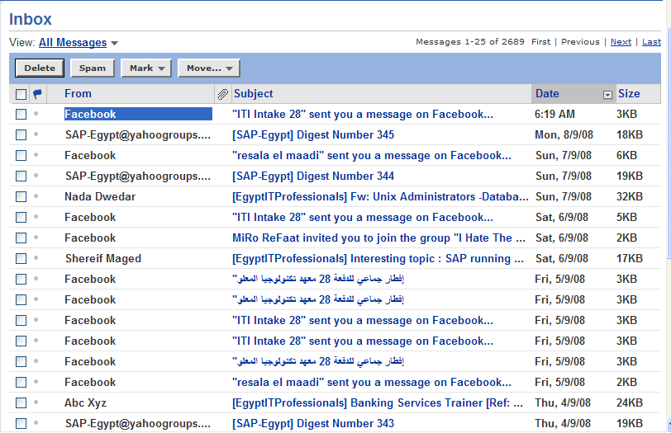
Example

Slide 6
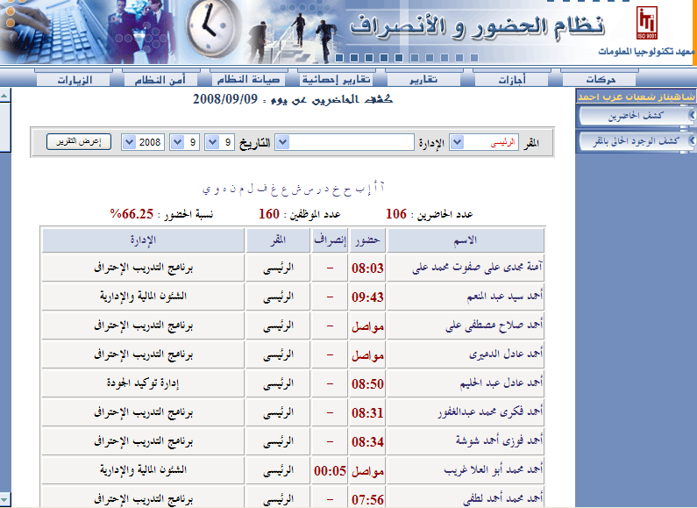

Example

Slide 7
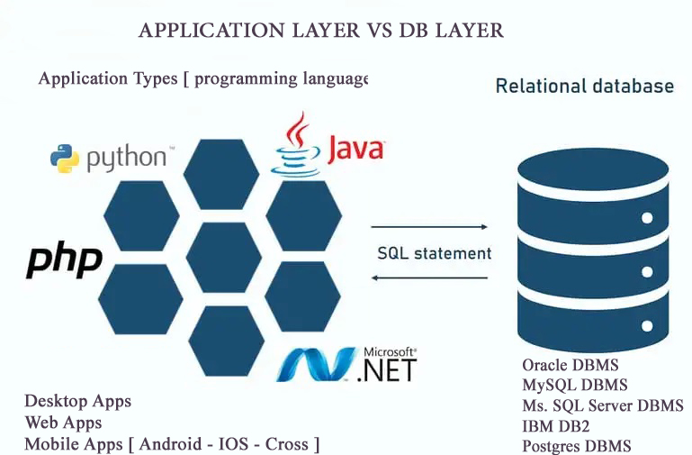
DB Layer vs Application Layer

Slide 8
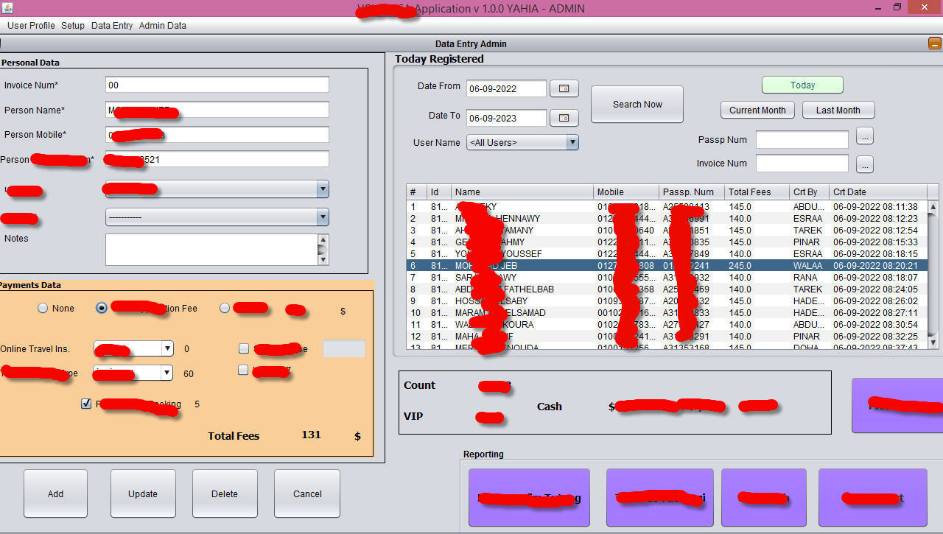
Desktop Application example
[java – C# - python ]

Slide 9

Web Application example
[java web – C# ASP.net – python web – php – node js ... ]

Slide 10
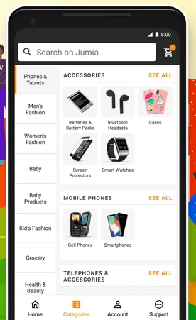
Mobile Application example
[Android java | kotlin – ios swift – cross Flutter ..]

Slide 11
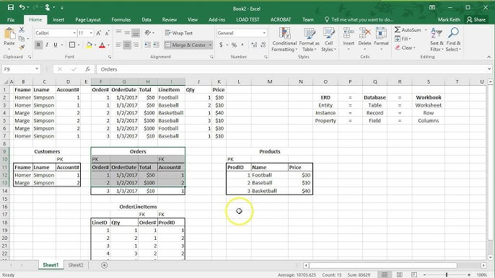
File Based System
It is a collection of programs that perform services for the end user.

Slide 12
Limitations Of File based System Approach
Separation & Isolation Of data ( no sync updates )
Duplication Of data
Program ( Software ) Data Dependence
Incompatible File Formats ( along products )
Security Problems

Slide 13
Basic Definitions
Database: A collection of related data.
Database Management System (DBMS): A software package/ system to facilitate the creation and maintenance of a computerized database.
Database System: The DBMS software together with the data itself. Sometimes, the applications are also included. ( Software + Database )

Slide 14
Database Systems Structure
Users
Database System - HR
Application Programs
DBMS Software
Memory
Software to process
Queries
Software to access Stored Data
Stored DB
Definition
(Metadata)
Stored
Database
Hard disk
Notes:
DBMS is a collection of programs that enables users to create and maintain a database. The DBMS is a software system that facilitates the process of defining, constructing, and manipulating databases for various applications. Defining a database involves specifying the data types, and constraints for the data to be stored in the database. Constructing the database is the process of storing the data itself on some storage medium. Manipulating a database includes such functions as querying the database to retrieve, update, delete specific data.
What are the other functions of DBMS ?
Data Security & Integrity , Concurrency , Recovery, Performance , Data Dictionary

Slide 15
DBMS Advantages
Controlling Redundancy. [ data duplication ]
Restricting Unauthorized Access.
Sharing data.
Enforcing Integrity Constraints القيود
Inconsistency can be avoided. [ data conflicts ]
Providing Backup and Recovery.

Slide 16
DBMS Disadvantages
DBMS is expensive
May be incompatible with any other available DBMS

Slide 17
Database Users : SDLC
Software development life cycle
System Analysts [ data gathering ]
Database Designer [ DB Design : erd ]
Database Administrator (DBA)
[ install and configure – engine performance - backup and recovery - security and roles .. ]
DB Developer and Application programmers [ App development ]
Tester
End users [ data entry / app users ]

Slide 18
DBMS Architecture
External Schema 1
External Schema 2
External Schema 3
Conceptual Schema
Physical Schema
Levels of Abstraction in a DBMS
(Three Schema Architecture)
Disk

Slide 19
Three Level/Schema Architecture
External – What the user sees: focus on what different types of users will see when viewing the database. They are concerned with what data the user will see and how the data will be presented to the user.
Conceptual – The logical model: focus on the logical nature of the data representation. They are concerned with what is represented rather than how it is represented.(define database structures such as tables and constraints)
Internal – The physical model: place the emphasis on how the data are represented in the database or on how the data structures are implemented in hdd.
Notes:
Database Model: a collection of logical constructs used to represent the data structure and the data relationships found within the database.
User models focus on what different types of users will see when viewing the database. They are concerned with what data the user will see and how the data will be presented to the user.
Logical models focus on the logical nature of the data representation. They are concerned with what is represented rather than how it is represented.
Physical models place the emphasis on how the data are represented in the database or on how the data structures are implemented.
External – What the user sees: deals with methods through which users may access the schema, such as through the use of a data input form. The external model allows relationships to be created between the user application and the data model.
Conceptual – The logical model: is the basic database model, which deals with organizational structures that are used to define database structures such as tables and constraints.
Internal – The physical model: deals with the physical storage of the database, as well as access to the data, such as through data storage in tables and the use of indexes to expedite data access. The internal model separates the physical requirements of the hardware and the operating system from the data model.

Slide 20
Data Models : Erd
High Level or Conceptual data models provide concepts that are close to the way many users perceive data, entities, attributes and relationships. (Ex. ERD)
Physical data models describes how data is stored in the computer and the access path needed to access and search for data.
Preview example

Slide 21
DBMS Other Functions
Spatial Data > GIS > Maps
Image / Audio / Video = blob data type = binary large objects
Time Series
Data mining > business intelligence

Slide 22
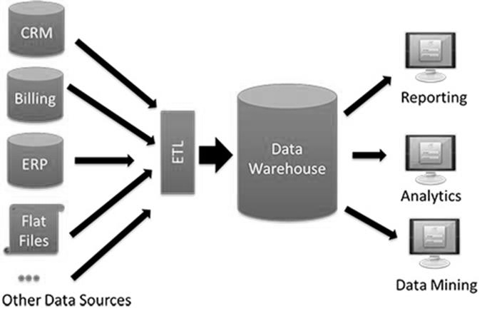
Data Warehouse
Extract,
Transform,
Load

Slide 23
Big Data concept
“Big Data” is data whose scale, distribution, diversity, and/or timeliness require the use of new technical architectures and analytics to enable insights that unlock new sources of business value.
Source: McKinsey May 2011 article Big Data: The next frontier for innovation, competition, and productivity

Slide 24
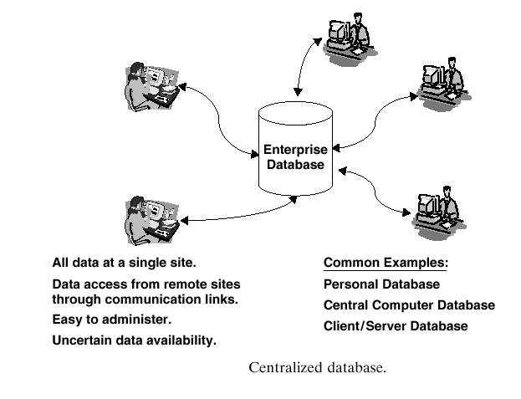
Database Environment

Slide 25
Centralized Database Environment
Mainframe environment
Client/Server environment
Internet Computing environment:
Notes:
Mainframe environment: consists mainly of a powerful mainframe that is networked with dumb terminals.
Client/Server environment: involves a main computer, called a server, and one or more personal computers that are networked to the server. The database resides on the server, a separate entity from the personal computer. Each user who requires access to the database on the server should have his/her PC.
Internet Computing environment: the application need only be installed on one server, called a web server. A user must have an internet connection and a supported web browser installed on the PC. The web server, in turn, accesses the database in a fashion supported by the application, and returns the requested information to the user’s web browser.

Slide 26
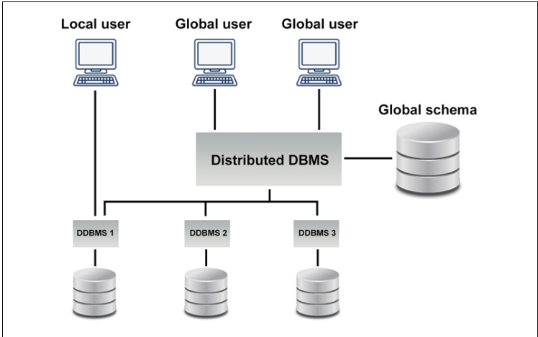
Distributed Database

Slide 27
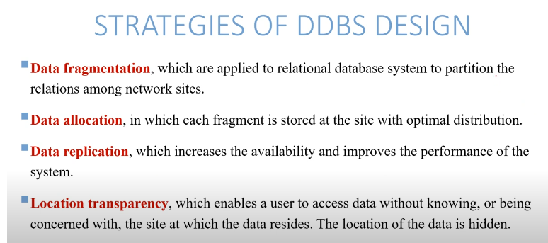
Distributed Database

Slide 28
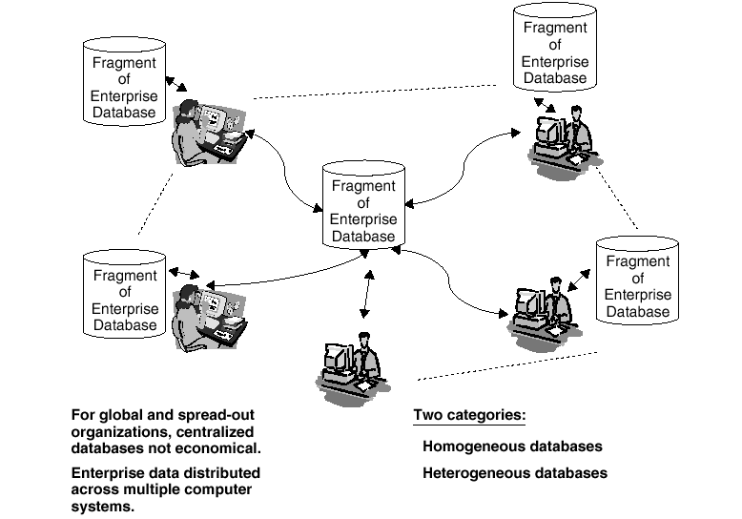
Distributed Database

Slide 29
Distributed Database
Details here

Slide 30
Non-relational Database (Nosql)
Non-Relational Database: unlike the relational database, there are no tables, rows, primary keys or foreign keys. Instead, the non-relational database uses a storage model optimized for specific requirements of the type of data being stored.
Also Known as NoSQL Database.
  NoSQL databases stands for Not Only SQL.
  NoSQL can use other types of query language rather than SQL.

Slide 31
Non-relational Database (Nosql)
There are 4 Different Types of NoSQL DB.
  Document (or Document Oriented) Data Stores [ mongo db ]
  Key-Value Stores
  Graph Stores
  Columnar (or Column Oriented) Data Stores
Notes:
Document-Oriented databases – Also known as a document store, this database is designed for storing, retrieving and managing document-oriented information. Document databases usually pair each key with a complex data structure (called a document).
Key-Value Stores – This is a database that uses different keys where each key is associated with only one value in a collection. Think of it as a dictionary. This is one of the simplest database types among NoSQL databases.
Wide-Column Stores – this database uses tables, rows, and columns, but unlike a relational database, the names and format of the columns can vary from row to row in the same table.
Graph Stores – A graph database uses graph structures for semantic queries with nodes, edges, and properties to represent and store data.
https://www.logianalytics.com/relational-vs-non-relational-databases/
https://www.pluralsight.com/blog/software-development/relational-vs-non-relational-databases

Slide 32
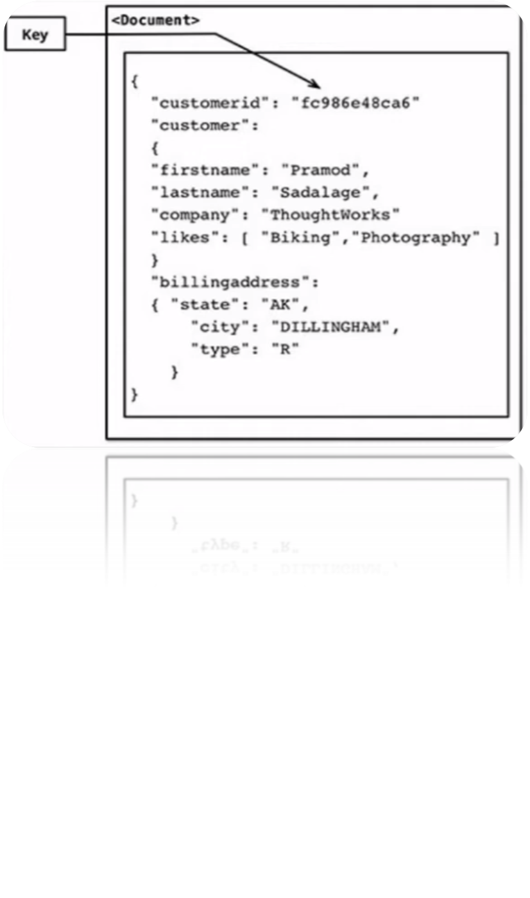
Non-relational Database (Nosql)
Document (or Document Oriented).
Notes:
Document-Oriented databases – Also known as a document store, this database is designed for storing, retrieving and managing document-oriented information. Document databases usually pair each key with a complex data structure (called a document).
Key-Value Stores – This is a database that uses different keys where each key is associated with only one value in a collection. Think of it as a dictionary. This is one of the simplest database types among NoSQL databases.
Wide-Column Stores – this database uses tables, rows, and columns, but unlike a relational database, the names and format of the columns can vary from row to row in the same table.
Graph Stores – A graph database uses graph structures for semantic queries with nodes, edges, and properties to represent and store data.
https://www.logianalytics.com/relational-vs-non-relational-databases/
https://www.pluralsight.com/blog/software-development/relational-vs-non-relational-databases

Slide 33
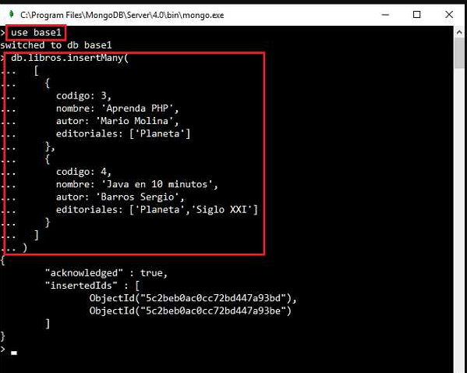
Non-relational Database (Nosql)
Insert example
Notes:
Document-Oriented databases – Also known as a document store, this database is designed for storing, retrieving and managing document-oriented information. Document databases usually pair each key with a complex data structure (called a document).
Key-Value Stores – This is a database that uses different keys where each key is associated with only one value in a collection. Think of it as a dictionary. This is one of the simplest database types among NoSQL databases.
Wide-Column Stores – this database uses tables, rows, and columns, but unlike a relational database, the names and format of the columns can vary from row to row in the same table.
Graph Stores – A graph database uses graph structures for semantic queries with nodes, edges, and properties to represent and store data.
https://www.logianalytics.com/relational-vs-non-relational-databases/
https://www.pluralsight.com/blog/software-development/relational-vs-non-relational-databases

Slide 34
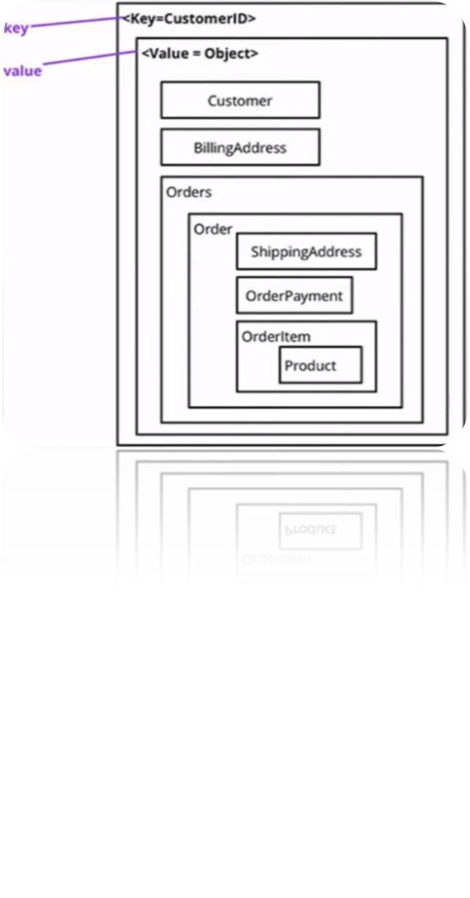
Non-relational Database (Nosql)
Key-Value
Notes:
Document-Oriented databases – Also known as a document store, this database is designed for storing, retrieving and managing document-oriented information. Document databases usually pair each key with a complex data structure (called a document).
Key-Value Stores – This is a database that uses different keys where each key is associated with only one value in a collection. Think of it as a dictionary. This is one of the simplest database types among NoSQL databases.
Wide-Column Stores – this database uses tables, rows, and columns, but unlike a relational database, the names and format of the columns can vary from row to row in the same table.
Graph Stores – A graph database uses graph structures for semantic queries with nodes, edges, and properties to represent and store data.
https://www.logianalytics.com/relational-vs-non-relational-databases/
https://www.pluralsight.com/blog/software-development/relational-vs-non-relational-databases

Slide 35
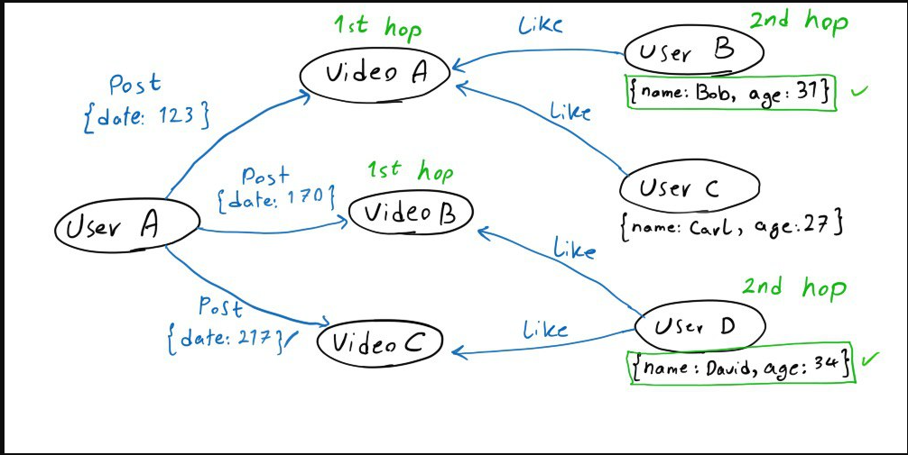
Non-relational Database (Nosql)
  Graph Stores
Notes:
Document-Oriented databases – Also known as a document store, this database is designed for storing, retrieving and managing document-oriented information. Document databases usually pair each key with a complex data structure (called a document).
Key-Value Stores – This is a database that uses different keys where each key is associated with only one value in a collection. Think of it as a dictionary. This is one of the simplest database types among NoSQL databases.
Wide-Column Stores – this database uses tables, rows, and columns, but unlike a relational database, the names and format of the columns can vary from row to row in the same table.
Graph Stores – A graph database uses graph structures for semantic queries with nodes, edges, and properties to represent and store data.
https://www.logianalytics.com/relational-vs-non-relational-databases/
https://www.pluralsight.com/blog/software-development/relational-vs-non-relational-databases

Slide 36
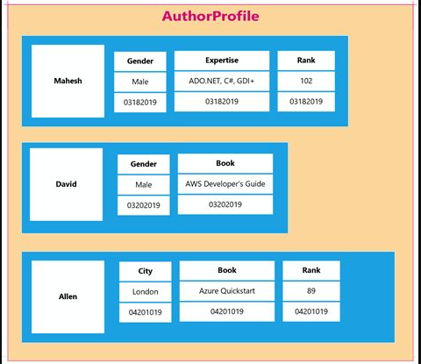
Non-relational Database (Nosql)
  Column Oriented Data Stores
Notes:
Document-Oriented databases – Also known as a document store, this database is designed for storing, retrieving and managing document-oriented information. Document databases usually pair each key with a complex data structure (called a document).
Key-Value Stores – This is a database that uses different keys where each key is associated with only one value in a collection. Think of it as a dictionary. This is one of the simplest database types among NoSQL databases.
Wide-Column Stores – this database uses tables, rows, and columns, but unlike a relational database, the names and format of the columns can vary from row to row in the same table.
Graph Stores – A graph database uses graph structures for semantic queries with nodes, edges, and properties to represent and store data.
https://www.logianalytics.com/relational-vs-non-relational-databases/
https://www.pluralsight.com/blog/software-development/relational-vs-non-relational-databases

Slide 37
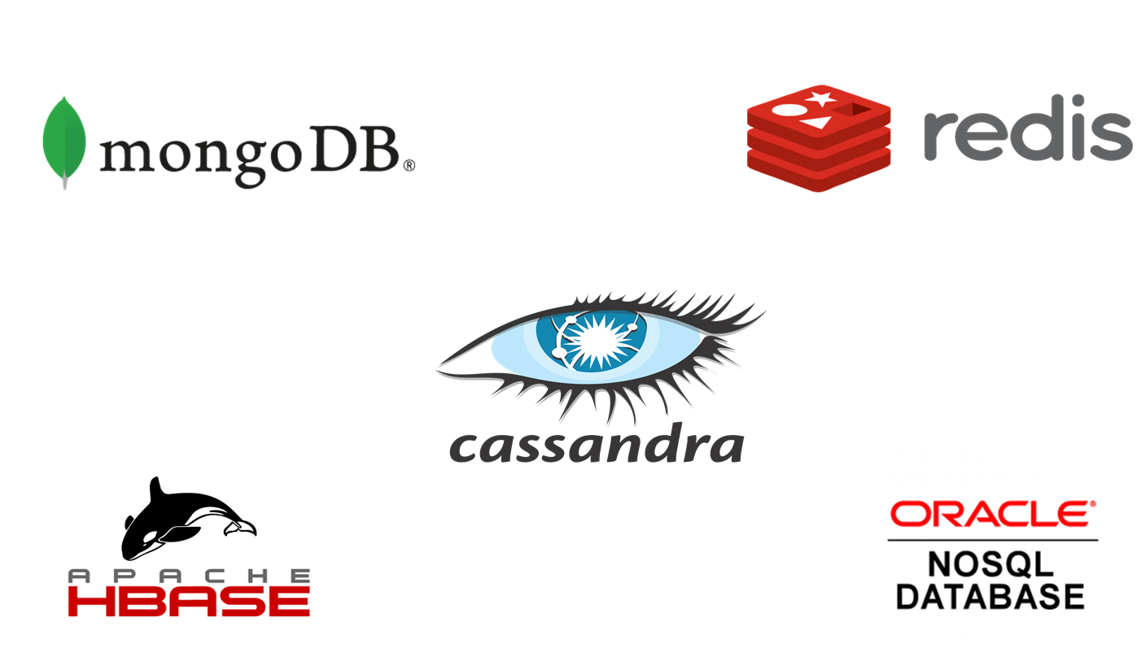

NoSQL Vendors
Document oriented
Key value based
Column based
Column based
Key value based
Graph based
Notes:
Document-Oriented databases – Also known as a document store, this database is designed for storing, retrieving and managing document-oriented information. Document databases usually pair each key with a complex data structure (called a document).
Key-Value Stores – This is a database that uses different keys where each key is associated with only one value in a collection. Think of it as a dictionary. This is one of the simplest database types among NoSQL databases.
Wide-Column Stores – this database uses tables, rows, and columns, but unlike a relational database, the names and format of the columns can vary from row to row in the same table.
Graph Stores – A graph database uses graph structures for semantic queries with nodes, edges, and properties to represent and store data.
https://www.logianalytics.com/relational-vs-non-relational-databases/
https://www.pluralsight.com/blog/software-development/relational-vs-non-relational-databases

Slide 38
Non-relational Database (Nosql)
When to use Nosql dbs
High data velocity : lots of data coming in very quickly, possibly from different locations
Data Variety : storage of data that is structured, un structured
Data volume : data that involves many terabytes or petabytes in size
Data complexity : data that is stored and managed in different locations or data centers
Notes:
Document-Oriented databases – Also known as a document store, this database is designed for storing, retrieving and managing document-oriented information. Document databases usually pair each key with a complex data structure (called a document).
Key-Value Stores – This is a database that uses different keys where each key is associated with only one value in a collection. Think of it as a dictionary. This is one of the simplest database types among NoSQL databases.
Wide-Column Stores – this database uses tables, rows, and columns, but unlike a relational database, the names and format of the columns can vary from row to row in the same table.
Graph Stores – A graph database uses graph structures for semantic queries with nodes, edges, and properties to represent and store data.
https://www.logianalytics.com/relational-vs-non-relational-databases/
https://www.pluralsight.com/blog/software-development/relational-vs-non-relational-databases

Slide 39
Questions ?

